Slide 1
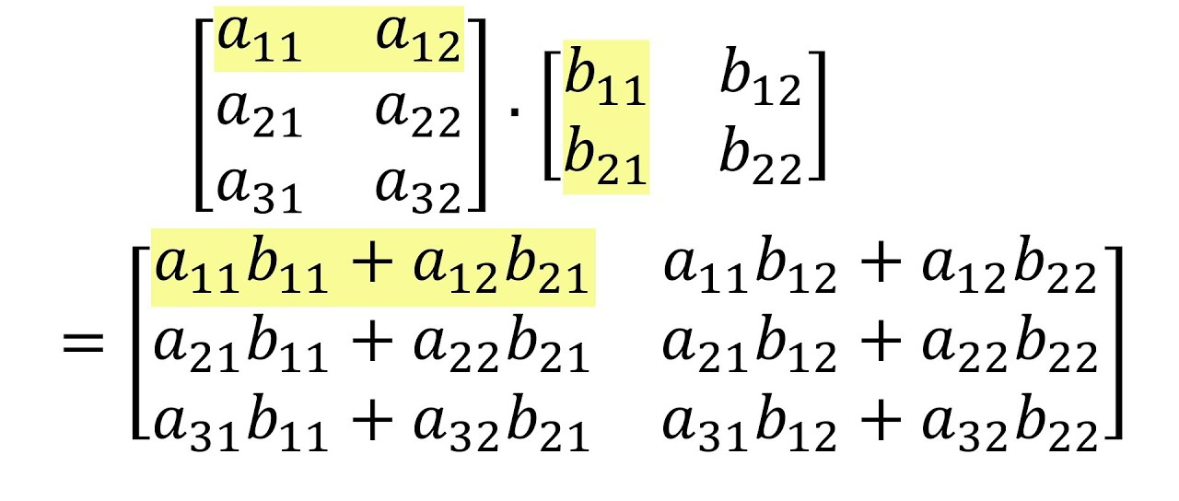
Programming Practice 01
Given two matrices, write a function to multiply them together:
print(mat_mult([[3, 3], [2, 2], [1, 1]],
[[2, 3], [3, 2]])
> [[15, 15], [10, 10], [5, 5]]
NOTE: I thought this was really
tricky and it took me a while!

Slide 2
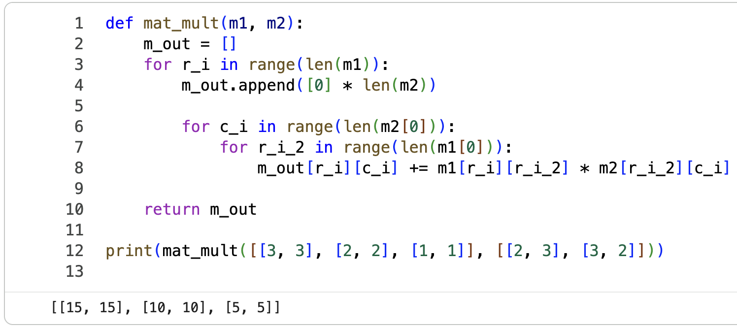
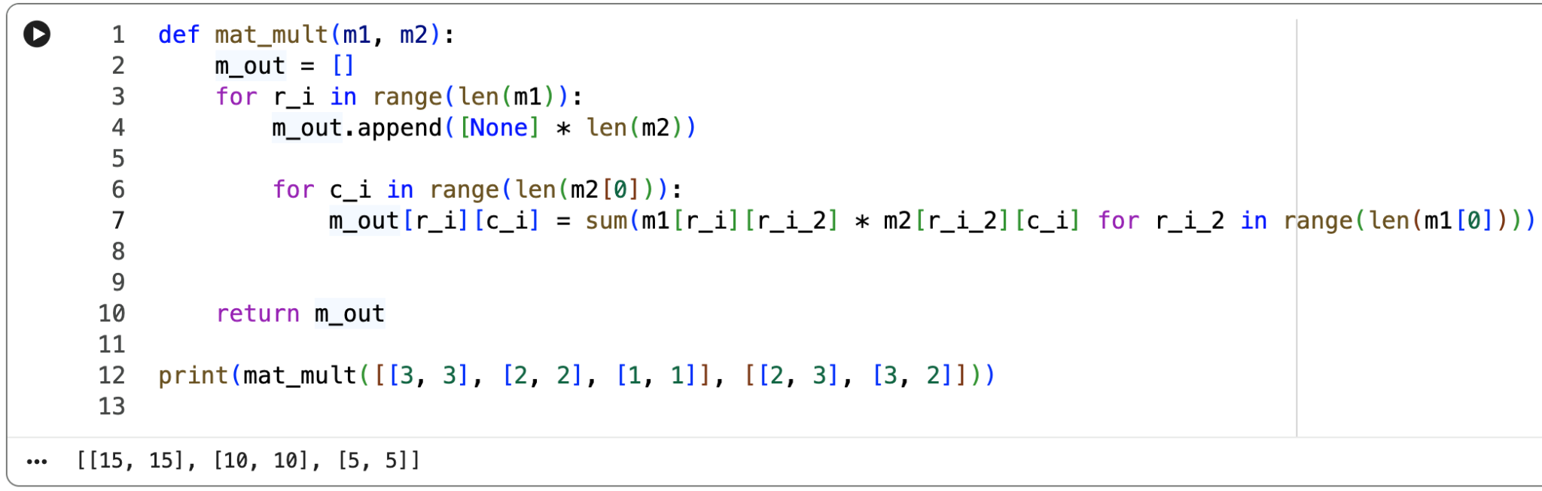
Programming Practice 01 Solution

Slide 3
CSE 10124 Learning Weights

Slide 4
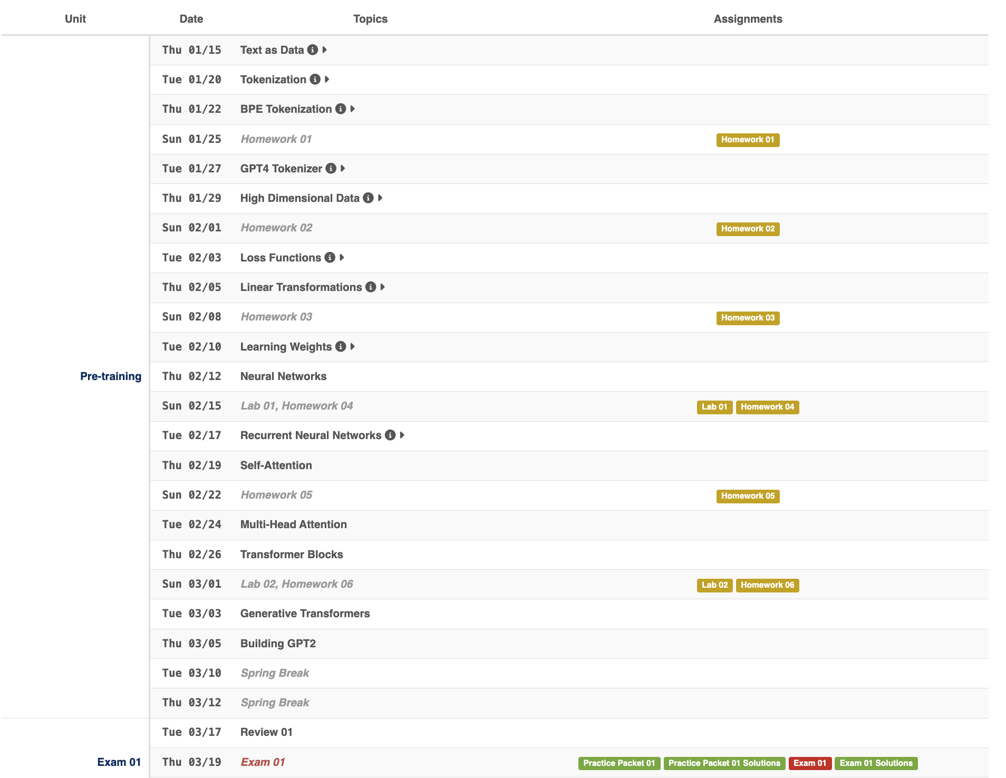
Proposed Schedule

Slide 5
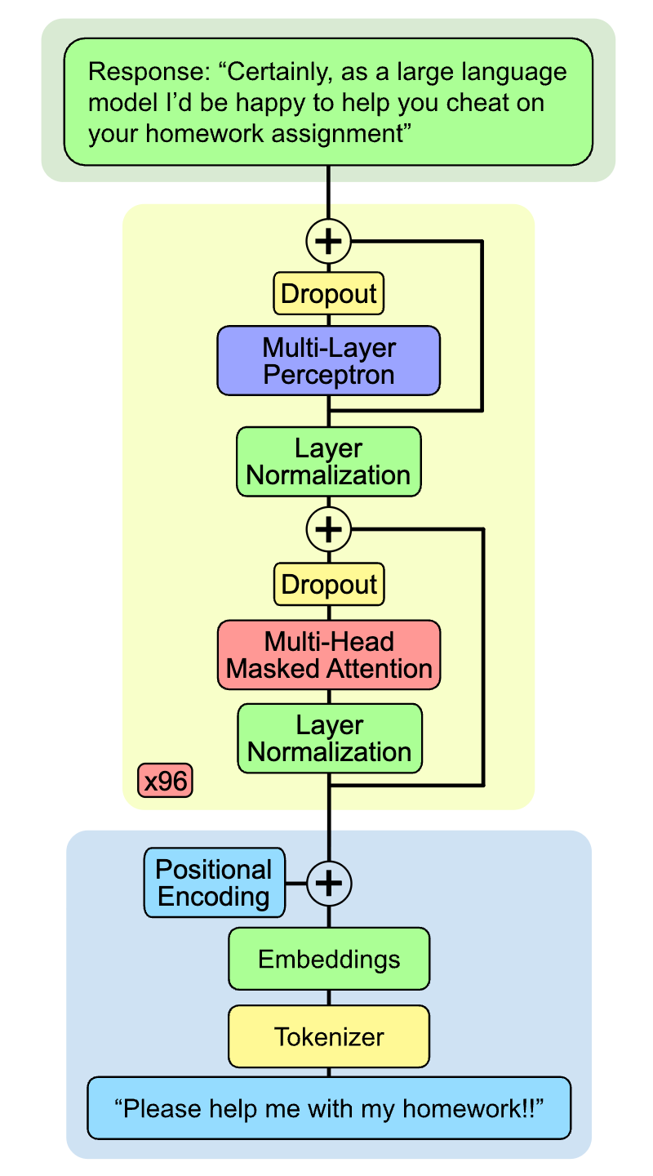
Where are we?
I lied!
Today we’ll talk about how we learn our weights.
This is called gradient descent

Slide 6
Training a Model
Ground Truth:
Hello there general
Prompt:
“Hello there”
Expected Output
<0.0, 1.0, 0.0, 0.0, 0.0, 0.0, 0.0, 0.0, 0.0, 0.0>
0 1 2 3 4 5 6 7 8 9
Tokens:
{“hello”: 3, “there”: 7}
Embeddings:
{3: <0.4, 0.3, …, -0.02>
7: <0.27, 0.8, …, 0.06>}
Cross Entropy Loss
= 1.97
Magic Box
SLM
Predicted Output
Predicted Output:
<0.19, 0.14, …, 0.08>
<0.19, 0.14, 0.12, 0.10, 0.09, 0.08, 0.07, 0.06, 0.07, 0.08>
0 1 2 3 4 5 6 7 8 9

Slide 7
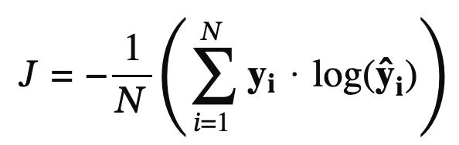
Deep Learning: Loss Functions
A loss function allows us to numerically measure how far off our model’s predicted values are from what we expected them to be, or what we know the right answer is.
Cross-Entropy: The loss function used to train LLMs is called “Cross-Entropy Loss” and it’s one of the most common loss functions. Heavily based on the principle of “entropy” as used in Information Theory, it’s a measure of how surprising our answer is relative to our ground-truth based on the entropy formula: -∑ p(x)log₂p(x)
Mostly outside the scope of the class, but it’s really not that complicated.

Slide 8
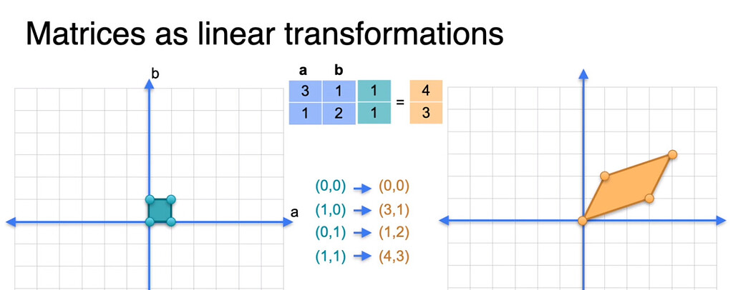
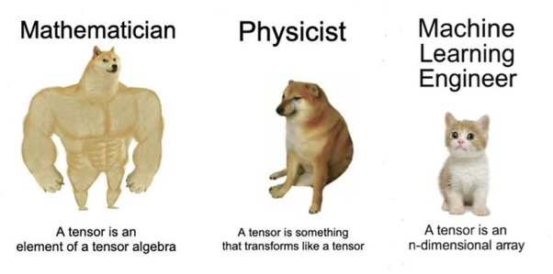
Linear Transformations
W
transformed (multiplied) by W
Output Vector: Ŷ
Input Vector: X

Slide 9
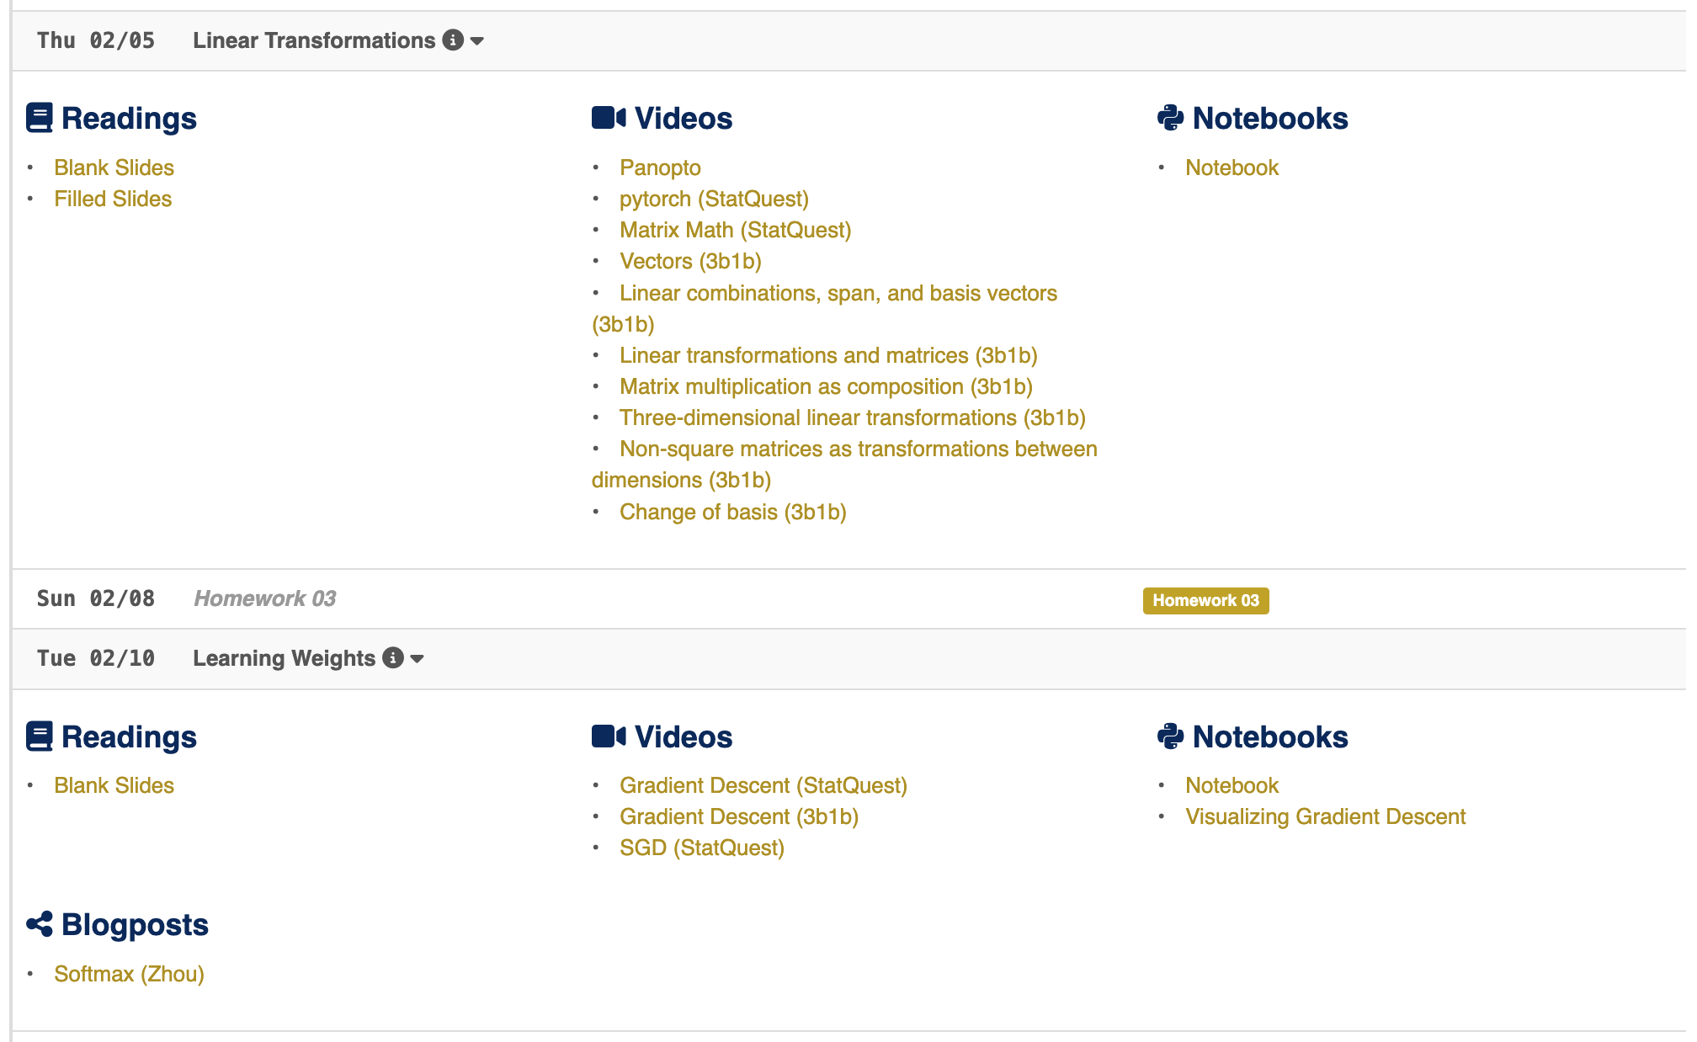
Additional Resources

Slide 10
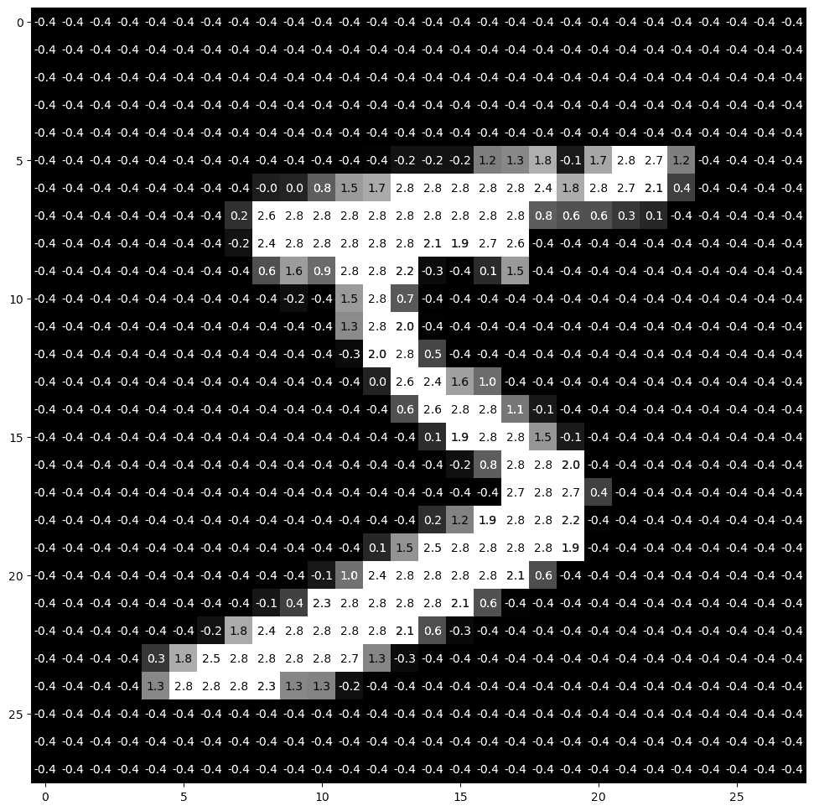
Writing MNIST “Equations”

Slide 11
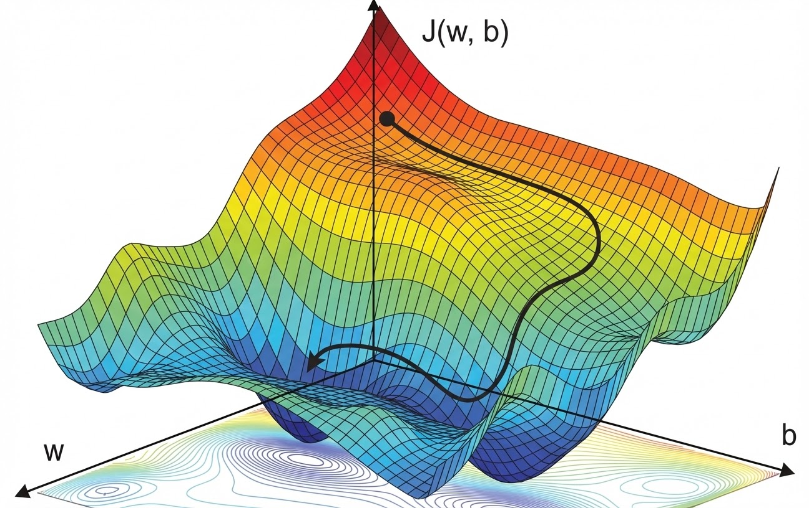
Gradient Descent

